Slide 1
Bamboos as an Alternative to Wooden Furniture
For Sustainable Goals

Slide 2
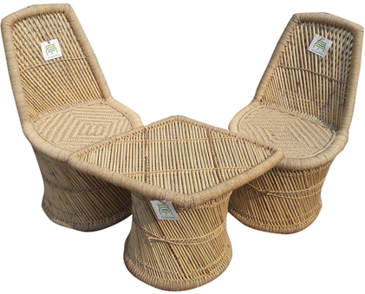
Introduction
With the increasing development of the global economy and regular increase in population, the comprehensive demand for wood as well as wood-based composites is gradually rising.
Bamboo is one of the “oldest building materials” utilized by mankind in both subtropical and tropical regions.
Bamboo culms have been used worldwide in different applications of building such as ceilings, walls, flooring, housing roof, fences, trusses, and rafters.
.To provide the reason for using Bamboo instead of wood materials, the benefits of this intervention will be addressed.
Fig: Bamboo Based Eco Furniture

Slide 3
Identification of Specific Area
Sustainable Material: Bamboo can be sustainably sourced and replenished, decreasing the carbon footprint associated with furniture production (Silva et al., 2020).
Carbon Sequestration: Bamboo has excellent capacity for sequestering carbon. It takes in a lot of carbon dioxide from the atmosphere when it is growing because it is a quickly growing plant (Lian et al., 2022).
Durability and Longevity: Furniture made of bamboo is renowned for its sturdiness and longevity. It has a longer lifespan than traditional furniture and can survive regular use in dorms for students (Felisberto et al., 2020).
Reduced Environmental Impact: Compared to furniture manufactured from conventional materials, bamboo furniture has a reduced environmental impact. When its use is over, it may be disposed of or composted without doing much damage to the environment.
Aesthetically Pleasing: The children are encouraged to feel comfortable and at ease thanks to the natural texture and warm tones of the bamboo.
Health and Wellbeing: Comparatively speaking to other furniture materials, bamboo furniture is renowned for its low toxicity. Students can breathe easier inside because it emits fewer formaldehyde and volatile organic compounds (VOCs) (Lian et al., 2022).

Slide 4
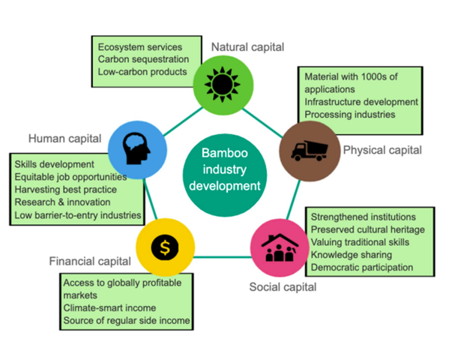
Description of the Chosen Intervention along with Benefits
Many business people view the growth of the bamboo industry as a climate-resilient and naturally sustainable source of income (Binfield et al., 2022), watershed regulation, along with land restoration.
Bamboo produces 35% more oxygen than an equivalent mass of trees, and researchers have been found that shown that it may absorb up to 12 (Binfield et al., 2022) tonnes of carbon dioxide per hectare each year.
. Bamboo is one of the useful and significant substitutes from nature to replace hardwoods along with 10-30% of annual enhancement in biomass against 2-4% for truest, bamboo significantly creates massive production of raw material for utilization (Yuan et al., 2022).
Due to this reason, eco-friendly furniture using bamboo significantly prevents huge deforestation as well as stops illegal activities on endangered species (Bumgardner and Nicholls, 2020).
Fig: Bamboo industry development as a mechanism for sustainable livelihood development
Source: (Binfield et al., 2022)

Slide 5
Identification of Specific Area
Sustainable Material: Bamboo can be sustainably sourced and replenished, decreasing the carbon footprint associated with furniture production (Silva et al., 2020).
Carbon Sequestration: Bamboo has excellent capacity for sequestering carbon. It takes in a lot of carbon dioxide from the atmosphere when it is growing because it is a quickly growing plant (Lian et al., 2022).
Durability and Longevity: Furniture made of bamboo is renowned for its sturdiness and longevity. It has a longer lifespan than traditional furniture and can survive regular use in dorms for students (Felisberto et al., 2020).
Reduced Environmental Impact: Compared to furniture manufactured from conventional materials, bamboo furniture has a reduced environmental impact.
Aesthetically Pleasing: The children are encouraged to feel comfortable and at ease thanks to the natural texture and warm tones of the bamboo.
Health and Wellbeing: Comparatively speaking to other furniture materials, bamboo furniture is renowned for its low toxicity. Students can breathe easier inside because it emits fewer formaldehyde and volatile organic compounds (VOCs) (Lian et al., 2022).

Slide 6
Evaluation of the Intervention Using Framework
To produce a thorough evaluation, combine primary data (surveys, interviews, observations) with secondary data (previous studies, reports).
Analyse the data gathered to gauge the intervention's effect on the chosen KPIs.
Compare the intervention's results to any applicable benchmarks or criteria.
Conduct a cost-benefit analysis to determine the financial effects of introducing bamboo-based green furniture.
Consult with all relevant parties, such as students, hostel staff, administrators, and sustainability specialists, to get their views.
Provide suggestions for strengthening the effectiveness of the intervention and fixing any flaws found in light of the evaluation's findings.
To disseminate the results of the review and encourage transparency, make use of a variety of communication channels, including presentations, reports, and online platforms (Felisberto et al., 2020).
Create a strategy for continued monitoring and follow-up to monitor the intervention's long-term effects.

Slide 7
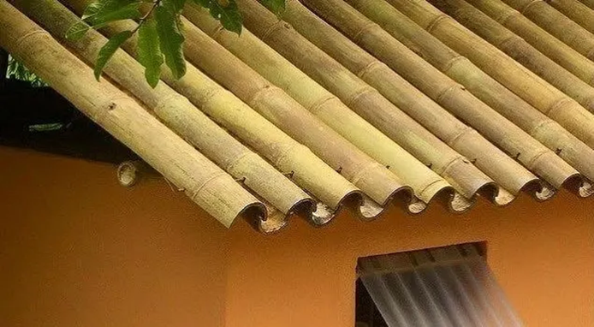
Discussion Solution against Traditional Solution
It is a material for making any type of furniture that provides its structure with ample sturdiness.
In an approach a technique bamboos are used for sustainable development it is believed to be a shield that has the potential to protect from various forces of nature and attacks of animas.
Resistant to heat again is a factor for products where bamboo has the capability to resist fire in high amounts along with the potential of withstanding 4000 degrees of Celsius temperature (Hildayanti, 2023).
Whereas on the other hand, wood has a high probability to get burned by fire as a result of rotting, asphalts are not fire-resistant which can result in cracking.
Fig: Bamboo Roofing
Source: (Hildayanti, 2023)

Slide 8
Conclusion
The advantages and viability of this intervention have been explored using secondary data and a thorough evaluation framework.
Bamboo is also non-toxic and low in volatile organic compounds, which helps to improve indoor air quality.
This study shows that by putting the suggested intervention into practice, student hostels can lessen their carbon footprint, improve the visual atmosphere, and give residents a healthier living space.
This study emphasises the value of bamboo as a practical material for making furniture, promoting its use and fostering a more sustainable future.

Slide 9
Reference List
Silva, M.F., Menis-Henrique, M.E., Felisberto, M.H., Goldbeck, R. and Clerici, M.T., 2020. Bamboo as an eco-friendly material for food and biotechnology industries. Current Opinion in Food Science, 33, pp.124-130.
Lian, C., Wang, X., Chen, H., Fei, B., Pang, X., Lian, J. and Wu, Z., 2022. Using Statistical Methods to Comparatively Analyze the Visual Characteristics of Flattened Bamboo Boards in Different Bamboo Culms. Polymers, 14(20), p.4327.
Felisberto, M.H.F., Silva, M.F., Menis-Henrique, M.E., Felisberto, M.H., Goldbeck, R. and Clerici, M.T., 2020. Bamboo as an eco-friendly material for food and biotechnology industries. Current opinion in food science.
Binfield, L., Britton, T.L., Dai, C. and Innes, J., 2022. Evidence on the social, economic, and environmental impact of interventions that facilitate bamboo industry development for sustainable livelihoods: a systematic map protocol. Environmental Evidence, 11(1), pp.1-12.
Yuan, T., Wang, X., Liu, X., Lou, Z., Mao, S. and Li, Y., 2022. Bamboo flattening technology ebables efficient and value-added utilization of bamboo in the manufacture of furniture and engineered composites. Composites Part B: Engineering, 242, p.110097.
Bumgardner, M.S. and Nicholls, D.L., 2020. Sustainable practices in furniture design: A literature study on customization, biomimicry, competitiveness, and product communication. Forests, 11(12), p.1277.
Hildayanti, A., 2023, April. Optimizing Bamboo as an Alternative Building Material to Respond Global Architectural Challenges. In IOP Conference Series: Earth and Environmental Science (Vol. 1157, No. 1, p. 012011). IOP Publishing.

Slide 10
Thank You

